Slide 1
Image Captioning
Michal Matzlavi and Tomer Stern

Slide 2
What is image captioning?
Image captioning is the process of automatically generating a textual description for an image. It combines computer vision and natural language processing (NLP) to interpret the contents of an image and describe them in a meaningful, human-readable way.
Actually, Image Captioning is the process of transforming visual data into lingual data.
Some examples:
Notes:
Michal:

Slide 3
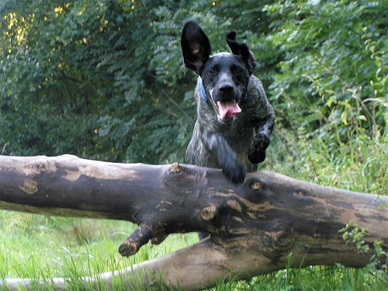
A black dog leaps over a log

Slide 4
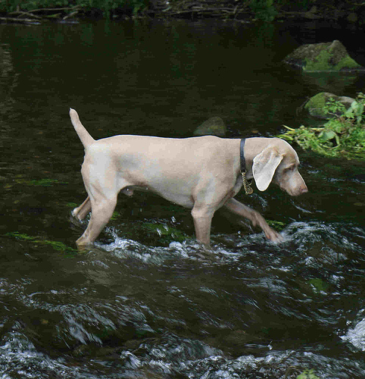
A light colored dog is walking through a stream

Slide 5
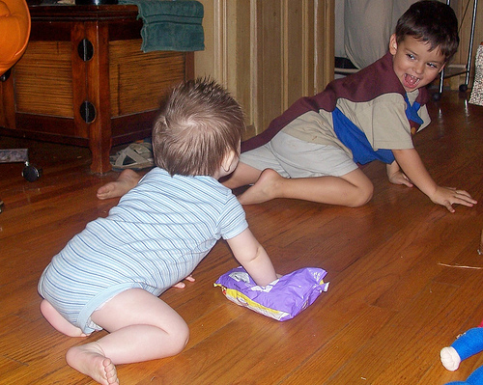
Two kids play on the floor

Slide 6
Why image captioning?
The technology of Image Captioning encapsulates great potential. It can help with helping Visually Impaired People to see through listening to generated texts, describe medical images (like X-rays or MRIs) to aid diagnosis, enhanced Search and Organization, improving efficiency in visual data analysis - and many more beneficial, and some creepy, developments.
Notes:
Tomer:

Slide 7
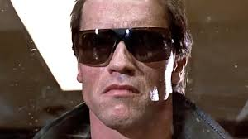
A man in a black shirt and a tie

Slide 8
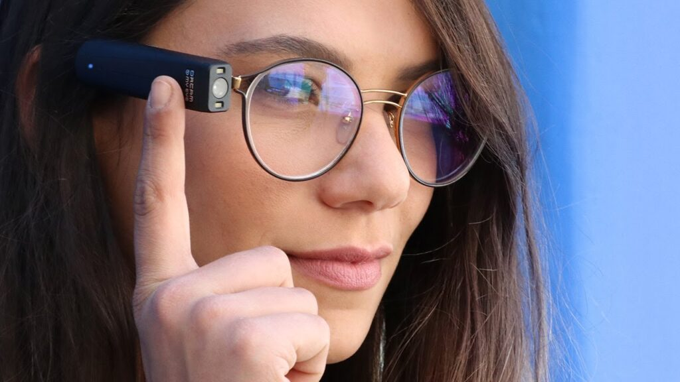
A woman with glasses is holding a cell phone

Slide 9
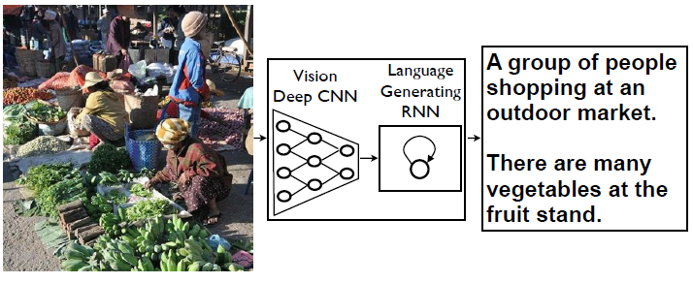
Our model
Our model consisted of 2 main parts, a CNN encoder and and RNN decoder.
Notes:
Michal:

Slide 10
Datasets
Took from Kaggle. The idea using those datasets came from this article: Show and Tell: A Neural Image Caption Generator (Bengio, 2015)
We used 3 different datasets, all containing images and captions that fit to each image, as should in classification tasks:
flickr 8k: 8,092 images, 5 captions per image, focusing on scenes involving humans and animals (dogs and kids) - test dataset.
flickr 30k: 31,783 images, 5 captions per image, longer version of flickr 8k - train and val dataset.
MScoco 2017: 118000+ images, 5 captions per image, everyday scenes, with objects in realistic contexts - train and val dataset.
Notes:
Tomer:

Slide 11
Preprocessing
Importing
Turning into dictionary
Transform
The different datasets were imported from Kaggle
The data was organized in a dictionary in the following manner: (key:image, value: captions)
The images were converted to RGB, resized, turned into a tensor and normalized.
Notes:
Michal:

Slide 12
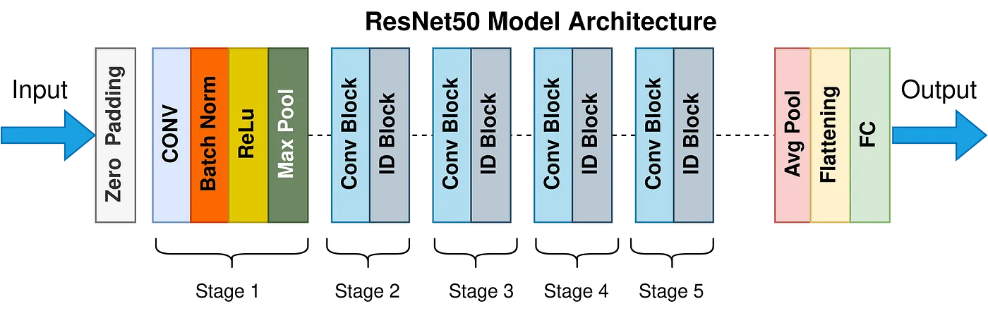
CNN encoder
We used an existing trained model called Resnet 50. ResNet-50 is CNN architecture that belongs to the ResNet (Residual Networks) family, a series of models designed to address the challenges associated with training deep neural networks. Developed by researchers at Microsoft Research Asia, ResNet-50 is renowned for its depth and efficiency in image classification tasks.
Notes:
Michal:

Slide 13
More preprocessing
Creating dataframes
Tokenizing the cations
Padding
Dataframes were created in order to not use the encoder each time. The dfs contained a captions column and a feature vector column. The df were saved to CSV format for later use.
The captions were tokenized according to a vocabulary that was created.
The captions were padded with the token <pad> and were randomly chosen to be fed to the dataloader.
Notes:
Tomer:Creating dfs minimizing capacity Loading dfs cleaning data importing captions from dfs and transforming to tokens randomly choose a caption and pad it insert to dataloader.

Slide 14
Vocabulary
The vocabulary was built from the words found in the captions with the addition of special characters: "<pad>", "<start>", "<end>", "<unk>".
Notes:
Michal: caption dataset

Slide 15
RNN decoder (LSTM)
Goal: Convert image features + partial caption (inputs) into the next word.
Inputs: Image Feature Vector (from encoder), Tokenized Caption (word indices converted via an embedding layer)
LSTM: Processes the “image feature + word sequence”, Maintains a hidden state for context
Fully Connected (FC) Layer: Projects LSTM outputs to a vocab-size distribution at each time step
Output: Probability distribution over the next word in the vocabulary
Notes:
Tomer and Michal: get into RNN Decoder : Inputs transform caption to tensors with 2048 dim Concat with CNN
LSTM Output loss function, optimizer and back propagation

Slide 16
How the Decoder Works
Embedding Layer: Converts each word index to a continuous vector
Feature as First “Token”: The image feature is prepended to the word embeddings, letting the LSTM “see” the image context first.
LSTM Forward Pass: Step-by-step processes image feature + each word embedding, updating hidden and cell states.
Vocabulary Projection: FC layer on each LSTM output → yields logits for every word in the vocabulary.
Training vs. Inference:
Training: Compare predicted words to ground-truth, use teacher forcing.
Inference: Generate tokens one at a time until an <end> token is reached.

Slide 17
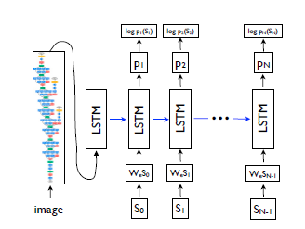

Slide 18
Training
Data: Batches of pre-extracted features (from a CNN) and tokenized captions.
Forward Pass: Decoder takes the image feature and all but the last caption token as input. Predicts each next word in the sequence.
Loss: Cross-Entropy against the shifted ground-truth words. Ignore <pad> so padding doesn’t affect gradients.
Backward & Update: Compute gradients via backprop. Adam optimizer adjusts the LSTM weights.

Slide 19
Product
Function - generate step.
Generate caption only by using image features only.
Final product is a single line function.

Slide 20
Demonstration time!
Notes:
Tomer

Slide 21
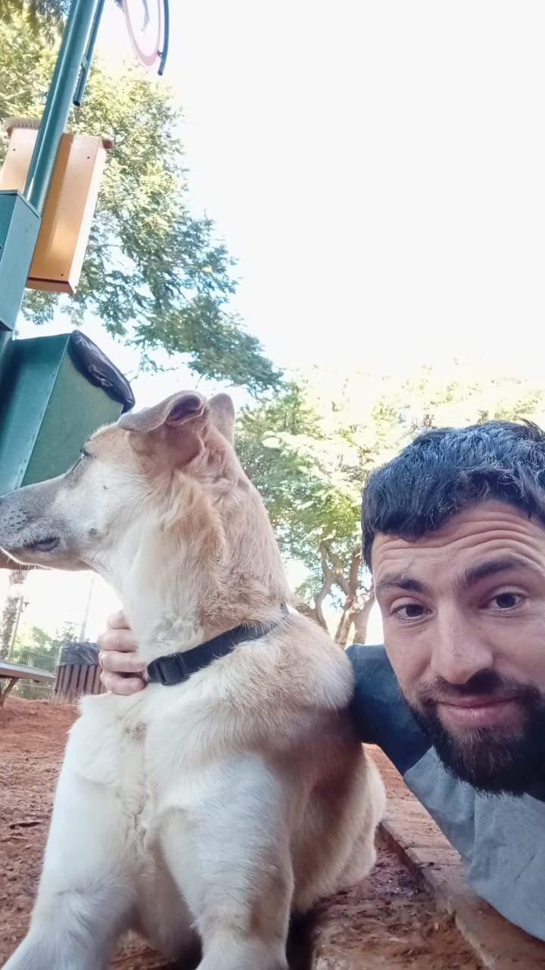
a dog is laying on a mans lap

Slide 22
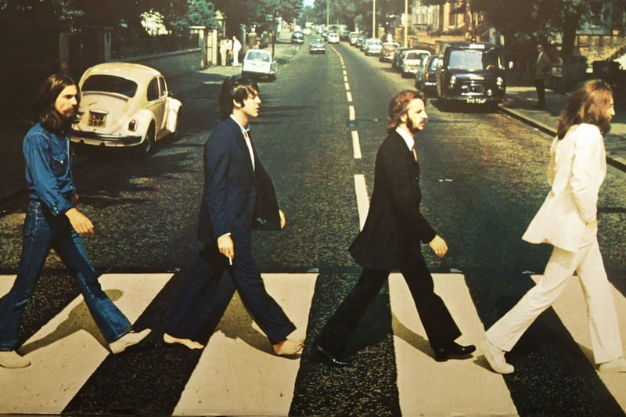
a group of people walking down a sidewalk

Slide 23

a man in a suit and tie holding a camera

Slide 24
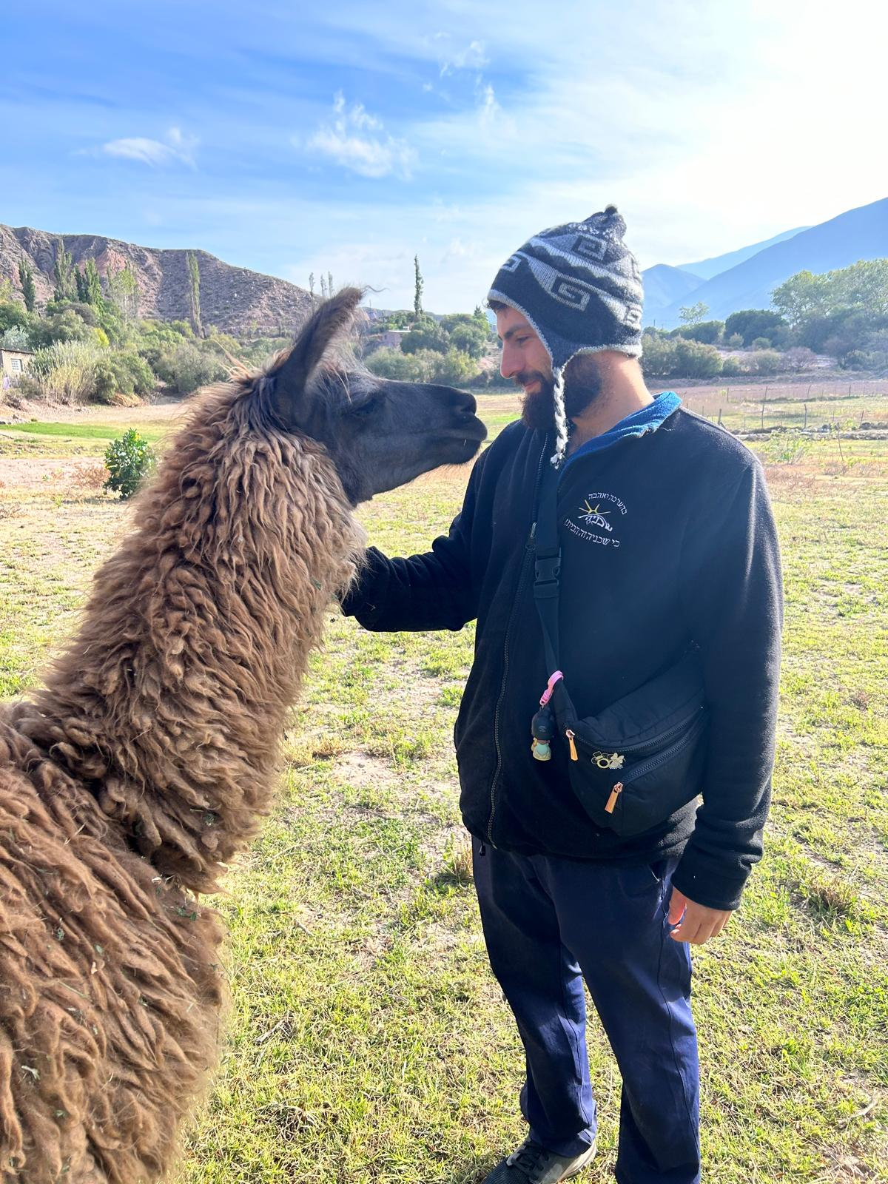
a man in a cowboy hat is petting a sheep

Slide 25
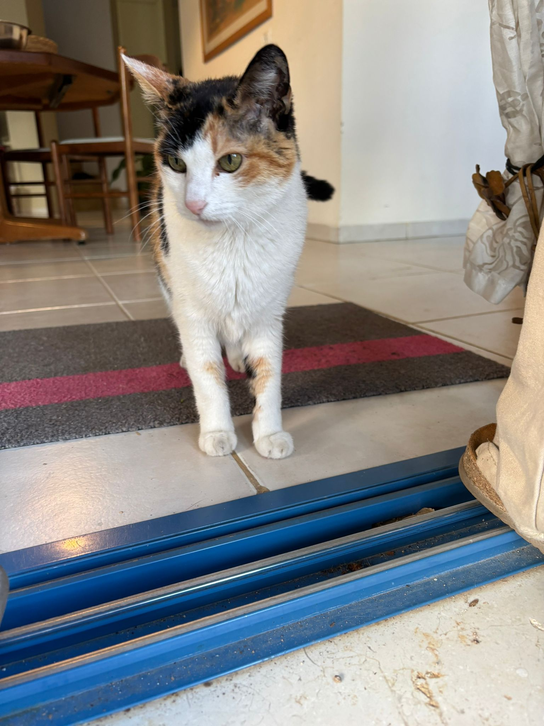
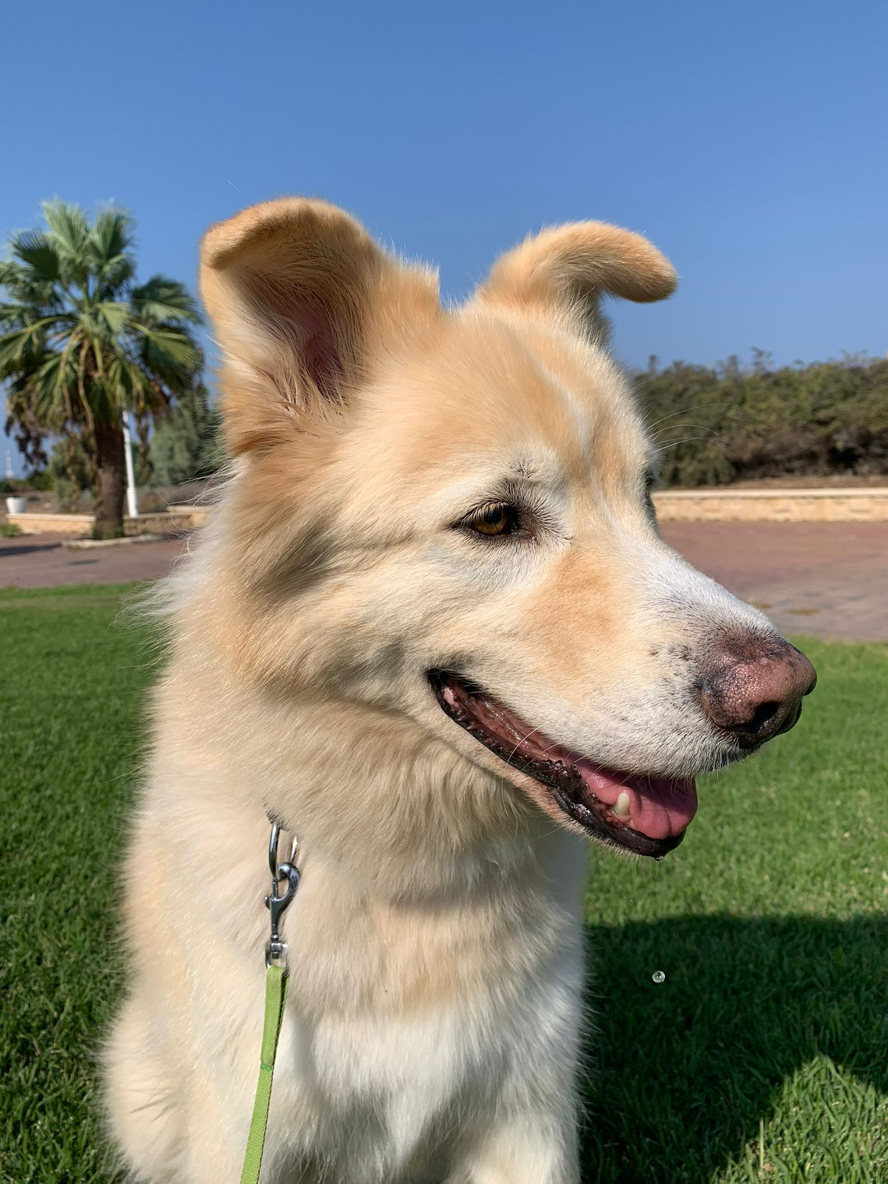
a cat is laying on a wooden chair
a dog sitting in the grass with a frisbee in its mouth

Slide 26
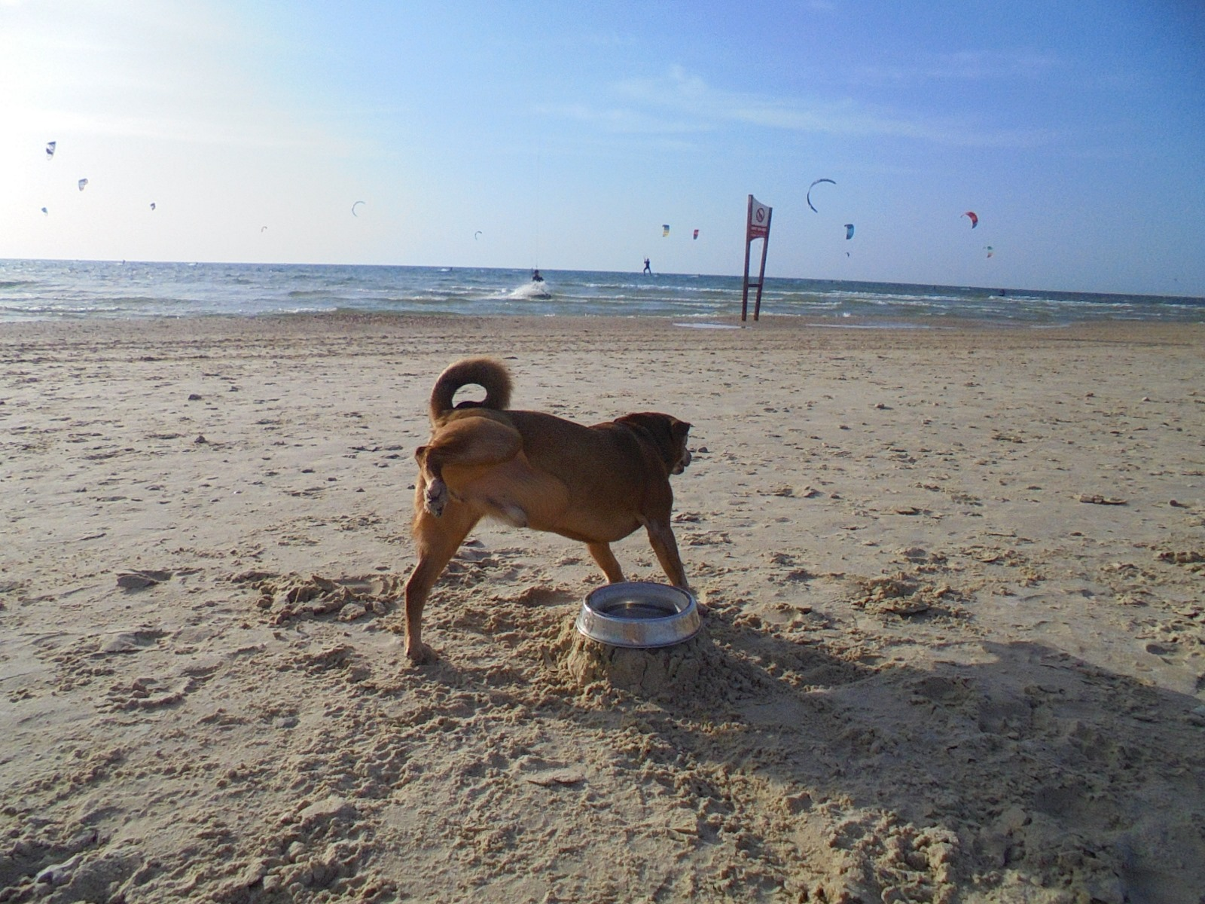
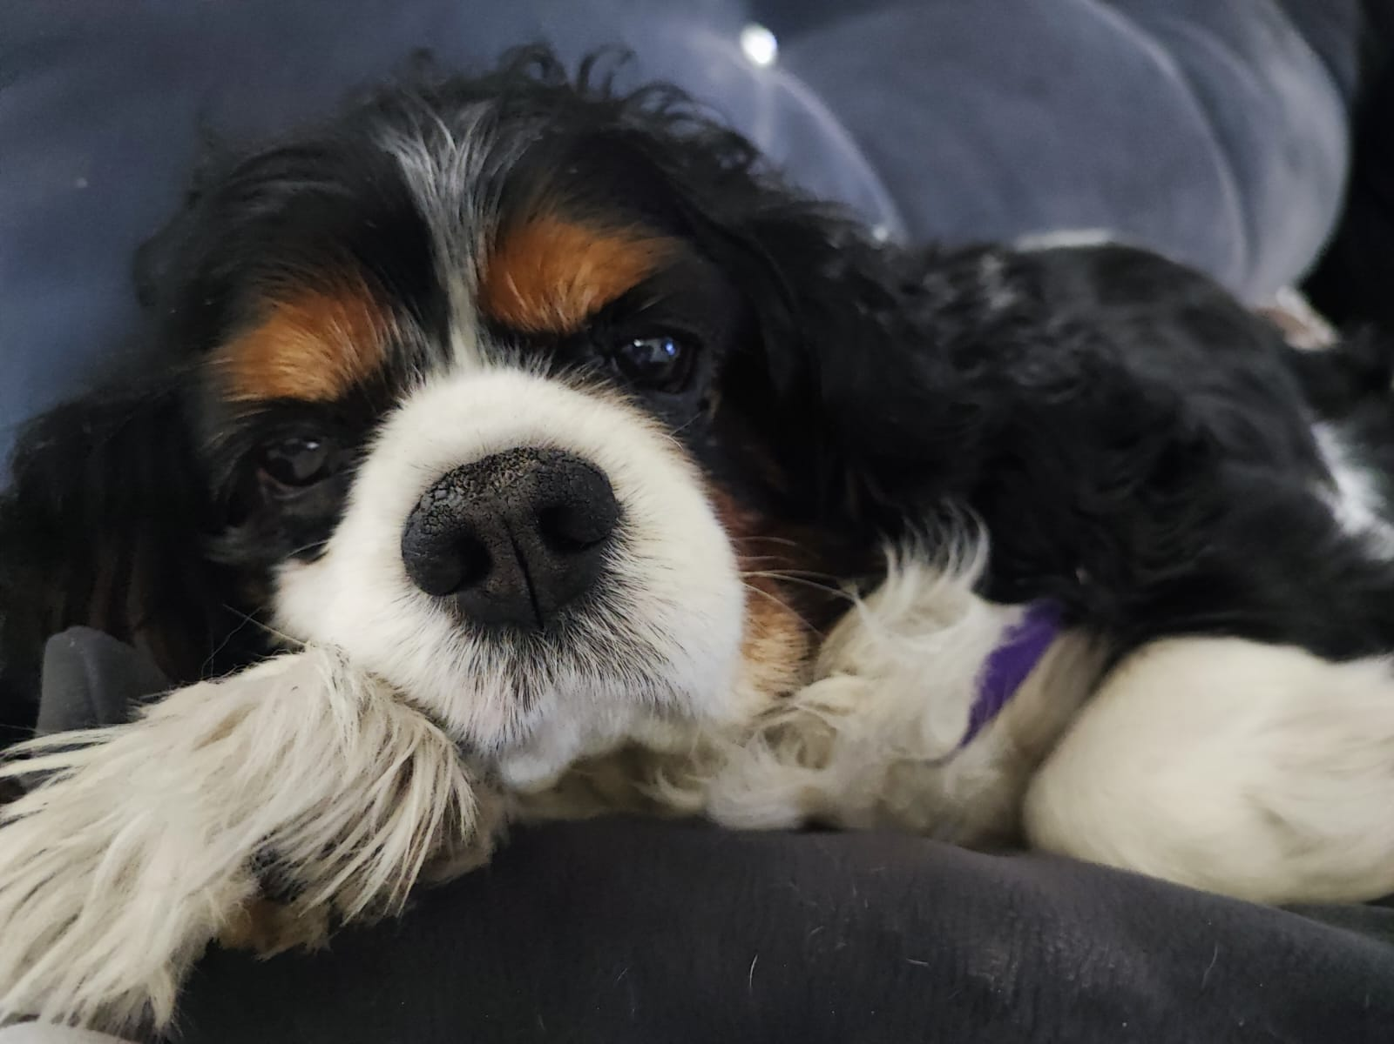
a dog is running on the beach
a dog laying on a bed with a remote control

Slide 27
The challenges we faced
Big datasets, but not big enough
Processing power
Hyperparameter tuning
Notes:
Tomer and Michal:

Slide 28
Bibliography
Mukherjee, S. (2022, August 18). The annotated RESNet-50 - towards data science. Medium. https://towardsdatascience.com/the-annotated-resnet-50-a6c536034758
Vinyals, O., Toshev, A., Bengio, S., & Erhan, D. (2015). Show and tell: A neural image caption generator. Computer Vision Foundation, 3156–3164. https://doi.org/10.1109/cvpr.2015.7298935

